Slide 1
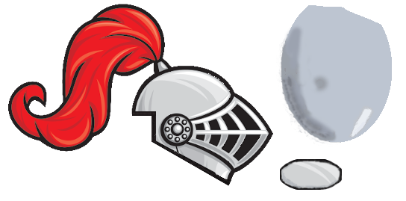
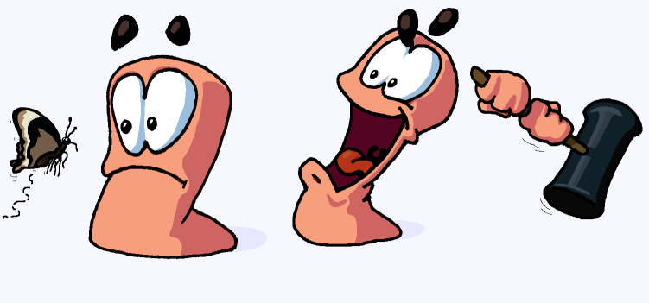
Team 4
Worms
smroW
By:
Alex ogilbee
Joseph Hill
Fernando Trevino

Slide 2
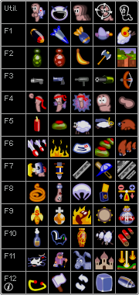
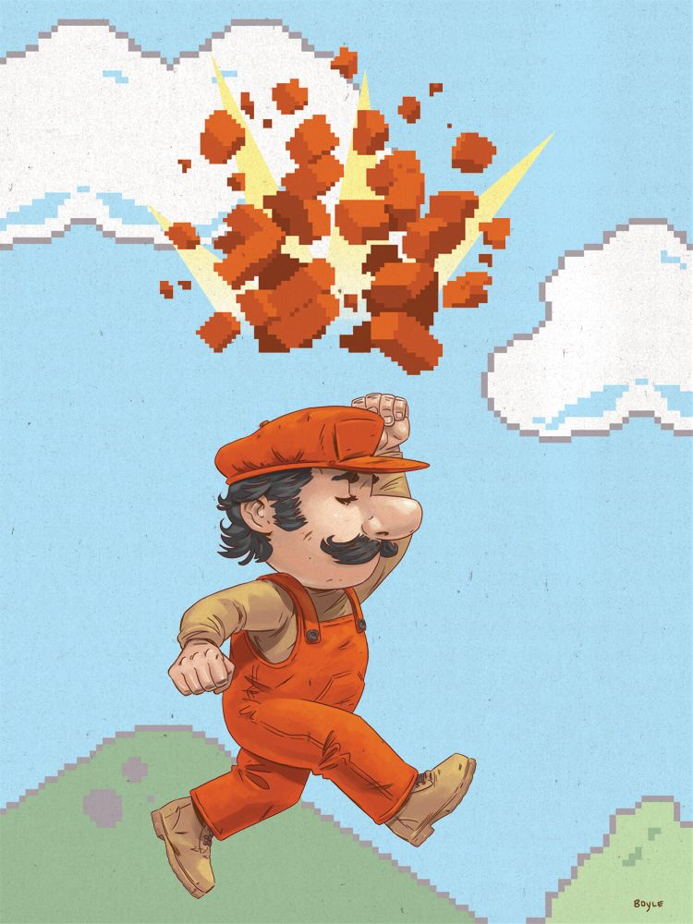
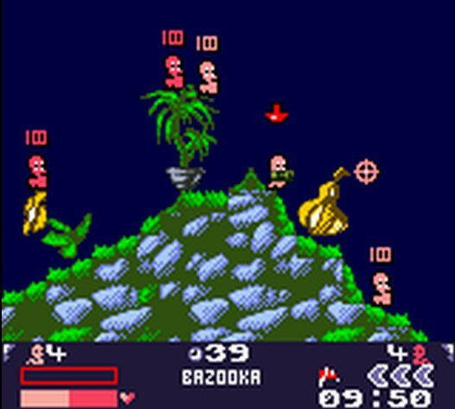
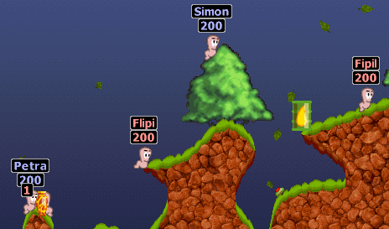
Game explanation
2D turn-based tactical shooter, inspired by Worms
Tile-based map
Each tile has its own health, not always destroyed on impact
Each map will have different environment behavior and hazards
Special weapons

Slide 3
Game Explanation
2D turn-based tactical shooter, inspired by Worms
Environment
Tile-based destroyable map
Environment adversaries such as the sun attacking you or water rising
Weapons and Tools
Arsenal of weapons shared by each team
Weapon Types: Gun, Launcher, Melee, Grenades
Tools: Teleporter, Tile Creator/Remover
Player Controls
WASD or Arrows for movement
Mouse for aiming

Slide 4


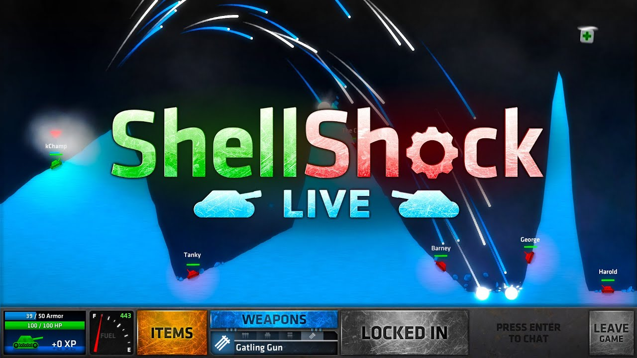

Game Decisions
Unity
Better than Game Maker and Unreal for 2D games (From what we know)
Prior experience
Why inspired by worms?
Popular game style
Turn-based system allows multiplayer with one computer

Slide 5
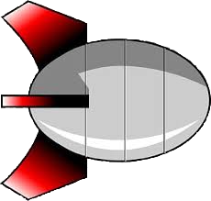

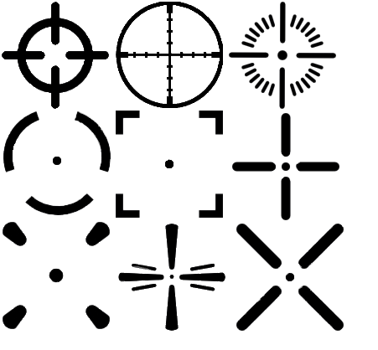









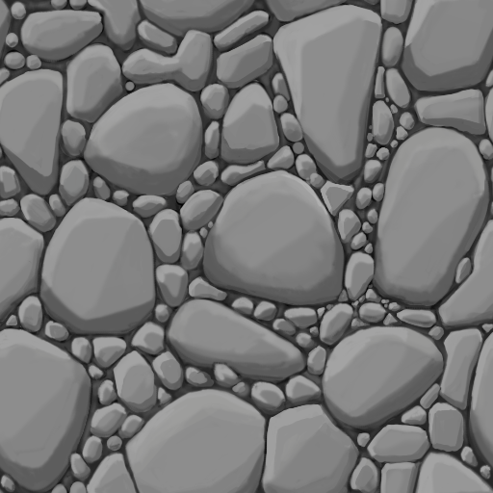

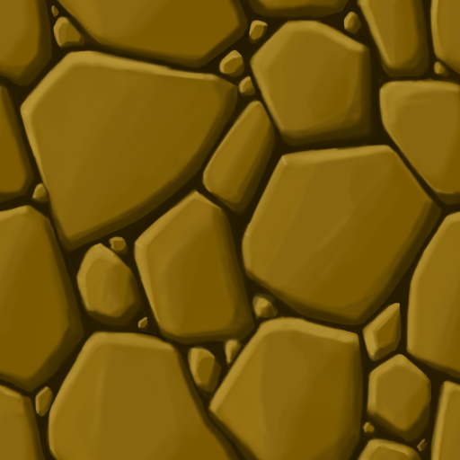
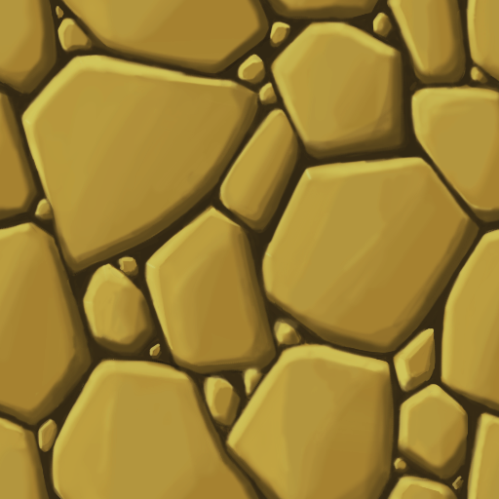
Art

Slide 6

Audio
We plan on finding fitting audio for ambient sounds, shooting, movement, the main menu, explosions, etc. from
Unity Asset Store
Itch.io
Freesound.org
If we can’t find existing sound FX we will make our own.

Slide 7
Task Breakdown
Alex
Menu Screens
Weapon UI
Weapon Implementation
AI movement
Joseph
Destructible Terrain
Map Generation
Environmental Hazards
WordPress
Fernando
Player Movement/Controls
Projectile Pathing
Collisions
AI targeting

Slide 8
High-Level Schedule
9/18 Presentation Day
Website, GitHub, Art Style and Some Assets, Player movement
10/9 First Playable
One premade map, Core weapons, Destructible terrain, Ability to start/finish match
11/18 Testing Day
Player AI, Procedural map generation, Full menu, More weapons, Environmental Hazards, Supply Crate Spawn
12/11 Game Day
Adjust for player feedback, Full weapon arsenal, AI difficulty levels, Settings Persistence

Slide 9
First Playable
One Complete Map
Premade, NOT generated
Core Weapons Implemented
Missile, Rifle, Grenade, Melee
Fully Player Controlled
No AI, only Player vs. Player
Working Game State
Match will play from start to finish
Rudimentary Weapon Swap
Destructible Terrain

Slide 10

Questions?

